Slide 1


Connecting
#14 Strapi & MongoDB

Slide 2

The most advanced Node.js Content Management Framework (Headless CMS) to build powerful API with no effort.
Before you go any further, ensure these technologies are installed on your computer:
Node.js at least v9.0.0
NPM at least v5.0.0
MongoDB at least v3.4
More info: https://strapi.io

Slide 3
#1 Activate MongoDB Server
Open terminal:
$ cd C:\Program Files\MongoDB\Server\3.6\bin
$ mongod –dbpath C:\data\db //jika belum//
$ mongod
If OK, it will show “Waiting for connections on port 27017”. Then open new terminal:
$ cd C:\Program Files\MongoDB\Server\3.6\bin
$ mongo

Slide 4
#2 Create Db, User & Collection
Membuat db strapi_db:
$ use strapi_db
Membuat db user:
$ db.createUser({user:"lintang",
pwd:"1234", roles:["readWrite", "dbAdmin"]});
Membuat collection “karyawan”:
$ db.createCollection('karyawan')

Slide 5

#3 Setup Strapi
Install Strapi CLI:
$ npm install strapi@alpha –g
$ strapi -v
Create Strapi project:
$ strapi new lin_strapi
Choose your database: MongoDB (recommended)
Database name: strapi_db
Host: 127.0.0.1
Port: 27017
Username: lintang
Password: 1234

Slide 6
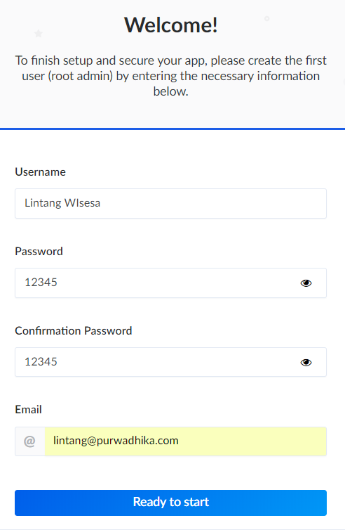
#4 Launch Server
then Create User
Enter project dir then launch the server:
$ cd lin_strapi
$ strapi start
Then open administration panel on browser (localhost:1337/admin) to create the first user!

Slide 7
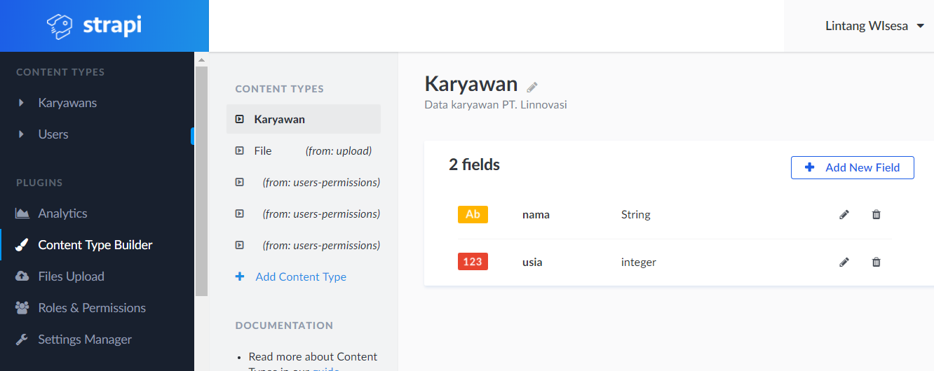
#5 Create Content Type
From Content Type Builder menu, create a content type (model) with several fields (props). Eg: Content: Karyawan with Fields: Nama (string) & Usia (number)

Slide 8
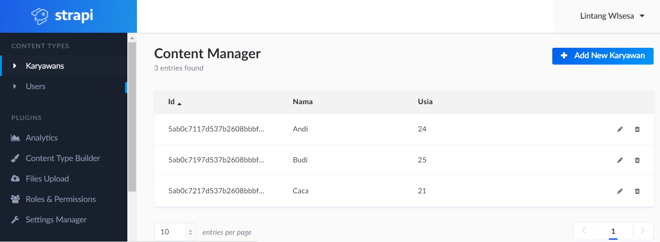
#6 Add Data to Content Type
Add some data to Karyawan:
Nama: Andi, Usia: 24
Nama: Budi, Usia: 25
Nama: Caca, Usia: 21

Slide 9
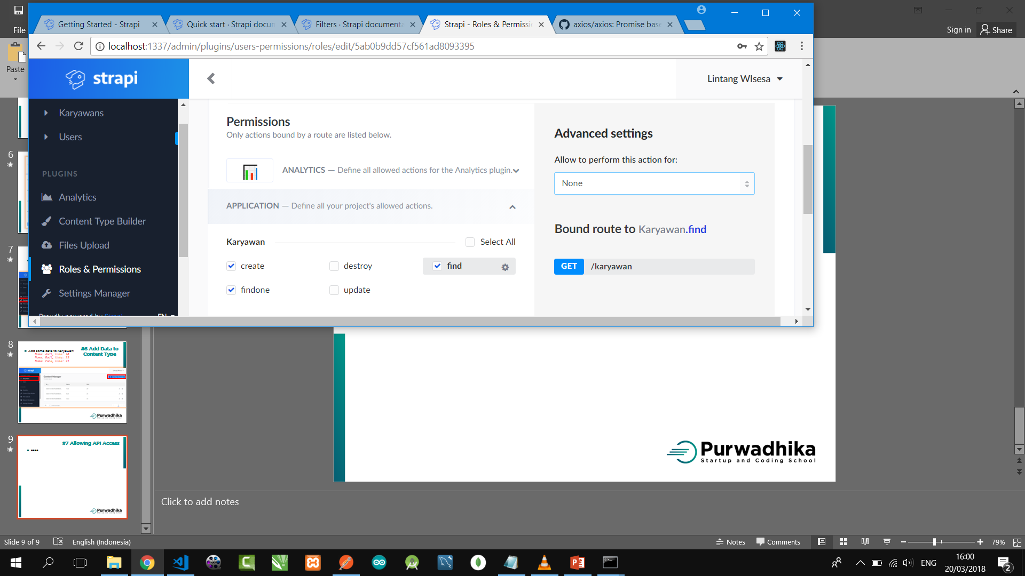
#7 Allowing API Access
From Roles & Permissions, click Public then select allowed actions.
Create - POST
Findone - GET :id
Destroy - DELETE
Update - PUT
Find - GET

Slide 10

A powerful GUI platform to make API development faster & easier, from building API requests through testing, documentation & sharing.
Postman has features for every API developer: request building, tests & pre-request scripts, variables, environments & request descriptions, designed to work seamlessly together.
Download from getpostman.com
Try to POST & GET
with POSTMAN!

Slide 11
#8 GET data
With Postman, try to GET data from Strapi API:
GET http://localhost:1337/karyawan
GET http://localhost:1337/karyawan?nama=Andi
GET http://localhost:1337/karyawan?usia_gte=22
GET http://localhost:1337/karyawan?_sort=nama:desc
GET http://localhost:1337/karyawan?_limit=30

Slide 12
Connecting
#14 Strapi & MongoDB

